Slide 1
Advanced Level Trenches & Excavations
University of Cincinnati
Department of Environmental and Public Health Sciences

Slide 2
Disclaimer
This material was produced under grant number SH-05166-SH9 from the Occupational Safety and Health Administration, U.S. Department of Labor. It does not necessarily reflect the views or policies of the U.S. Department of Labor, nor does mention of trade names, commercial products, or organizations imply endorsement by the U.S. Government.

Slide 3
Introduction
In this course we will develop a thorough understanding of excavations and trenches and then focus on high level concepts for those with management and safety responsibilities in the field.
Notes:
The purpose is to ensure you have a solid understanding of trenches and excavations and a clear picture of how to always have a safe one.

Slide 4
Learning Objectives
Identify worker rights under the OSH Act
Define 15-20 key terms associated with the hazards and the safeguards of trenches and excavations
Discuss injury and illness statistics for trench and excavation work

Slide 5
Learning Objectives
Explain how to identify and avoid trenching and excavation hazards
Explain the physics and characteristics of soil and explain the different methods of soil testing
Describe a trench and excavation safety program that meets all requirements of OSHA subpart P

Slide 6
Learning Objectives
Demonstrate how to recognize and abate trenching and excavation hazards
Describe the role and responsibilities of a competent person according to OSHA subpart P
Describe best practices to protect workers from cave-ins

Slide 7
Learning Objectives
Pre-class Quiz

Slide 8
Pre-Assessment (Q1)
Structural ramps used solely by employees as a means of access and egress from excavations shall be designed by a:
Qualified Engineer
Competent Person
Architect
Employees
Notes:
The Answer is B

Slide 9
Pre-Assessment (Q2)
2. Excavations must be inspected daily by an Authorized Person.
True
False
Notes:
The Answer is B

Slide 10
Pre-Assessment (Q3)
3. A “Trench Shield”, commonly known as a “Trench Box” in the field, is an engineered system designed to protect those who are working in a trench.
a. True
b. False
Notes:
The Answer is A
This question may be confusing for students and the instructor should state that a “Trench Shield” is commonly known as, or commonly referred to as a “Trench Box” in the course.

Slide 11
Pre-Assessment (Q4)
4. A Trench and an Excavation is the same thing:
True
False
Notes:
The Answer is B

Slide 12
Pre-Assessment (Q5)
5. Excavations greater than _____ ft. shall be tested before employees enter where potentially ______________ atmospheres could reasonably exist.
4’, Hazardous
4’, Ambient
6’, Hazardous
6’, Ambient
Notes:
The Answer is A

Slide 13
Pre-Assessment (Q6)
6. The bottom of a trench shield (trench box) should be no more than ______ ft. above the bottom of the trench or excavation?
5’
3’
1’
2’
Notes:
The Answer is D

Slide 14
Pre-Assessment (Q7)
7. ___________ cause/causes the most deaths in excavations.
Underground utilities
Water accumulation
Cave ins
Heavy equipment
Notes:
The Answer is C

Slide 15
Pre-Assessment (Q8)
8. In excavations deeper than 4’ a means of exit _________.
Is not needed
Must be located within 100’ of workers
Must be located within 200’ of workers
Must be located within 25’ of workers
Notes:
The Answer is D

Slide 16
Pre-Assessment (Q9)
9. Which of the following statements is not true about Type C soil:
If type is unknown, you should assume all soil is Type C
If sloped, it requires an angle of 34°
It can be benched
Type C soil is usually very loose and prone to cave in
Notes:
The Answer is C

Slide 17
Pre-Assessment (Q10)
10. ______________ involves angling back the material in a continuous plane.
Shoring
Shielding
Sloping
Benching
Notes:
The Answer is C

Slide 18
Worker Rights
  Workers have the right to:
  A Safe workplace
  Certain employer provided information
  Make safety complaints
  Receive training
  Participate in OSHA inspections
Notes:
Workers may request and receive information form the employer on OSHA’s rules and regulations, mandatory measuring or monitoring of toxic substances, and emergency procedures.
They can also make formal complaints in confidence to OSHA, receive OSHA mandated training, and participate in the “walk around” portion of an OSHA inspection.

Slide 19
Worker Rights
  Workers have the right to:
  Refuse to perform dangerous work
  Examine OSHA records
  Hazardous chemical information
  Medical records
Notes:
Workers may refuse to perform dangerous work if they reasonably believe there is a threat of serious injury or death and the employer refuses to correct the condition after the employee requests it.
They also have access to examine the OSHA 300 log of recordable injuries and illnesses, obtain safety data sheets for hazardous chemicals, and view work-related medical and exposure records.

Slide 20
Worker Rights
  Workers have the right to:
  Contest the abatement period
  Participate in enforcement proceedings
  “Whistleblow” on employers
  Protection from discrimination
Notes:
Workers have the right to contest an abatement period given to an employer by OSHA, intervene in enforcement proceedings against the employer, and report unsafe conditions or practices to OSHA without fear of retaliation from the employer.

Slide 21
Definition
Excavation:
  any man-made cut, cavity, trench, or depression in an earth surface, formed by earth removal
Notes:
Excavation-This definition is from OSHA.

Slide 22
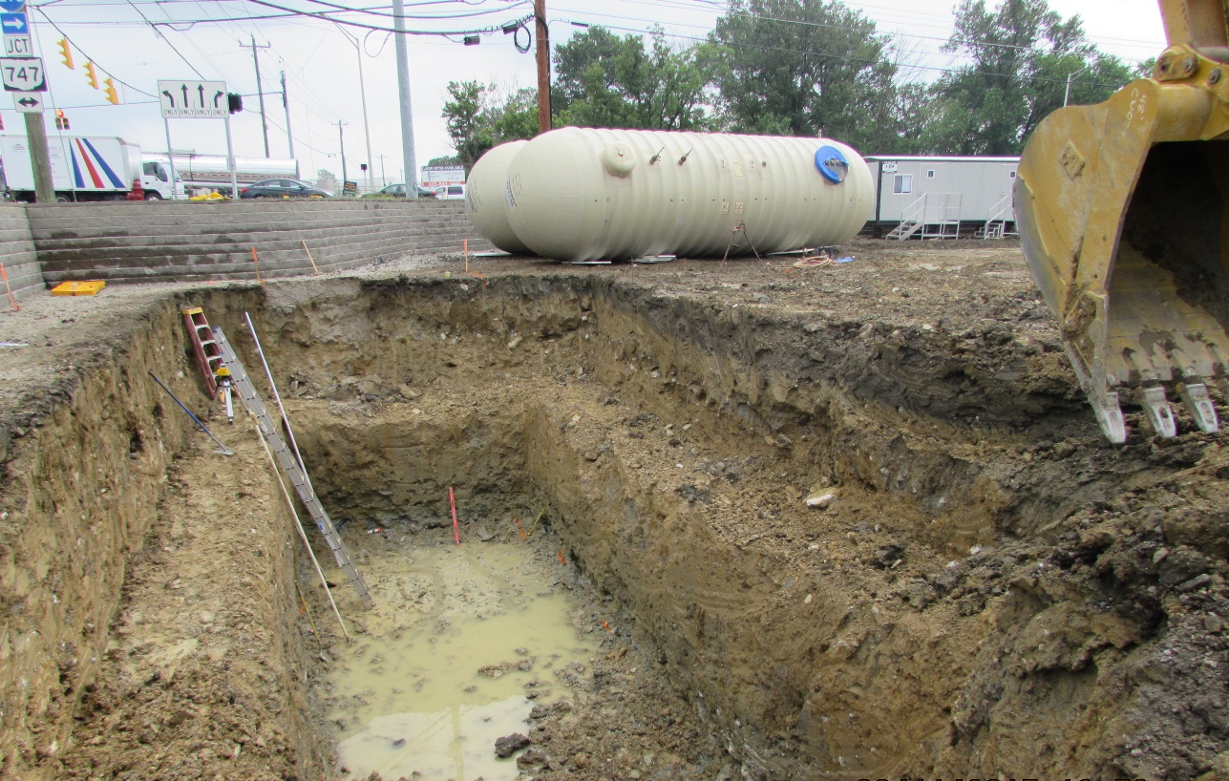
Example
Excavation
Notes:
This is an excavation near a parking lot.
Photo Credit-David Ponder.

Slide 23
Hazards Identified within the Photo
Material/Equipment/Spoils must be kept back 2’
Improper use of a Step-Ladder
Improper Bench
This has caused the slope to become too shear
Improper Ladder Angle
B
Water can not be allowed to pool in the bottom
The first bench has to be double the height to a max of 4’. So if the bench is 4’ (A) tall the width would have to be 8’ (B)
A

Slide 24
Definition
Trench (or trench excavation):
  a narrow excavation (in relation to its length) made below the surface of the ground.
  generally deeper than it is wide, but not more than 15 ft. wide at the bottom.
  can also be made by having forms or other structures inside an excavation.

Slide 25
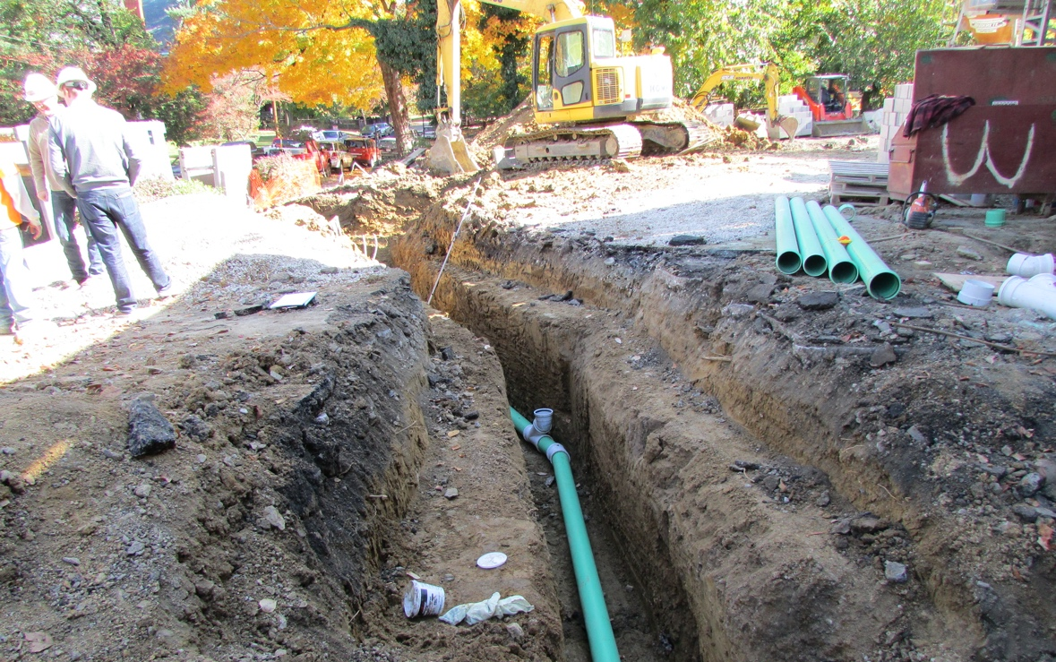
Example
Trench for water line

Slide 26
Definition
Cave-in:
  separation of a mass of soil or rock material from the side of an excavation….in sufficient quantity so that it could entrap, bury, or other wise injure and immobilize a person
Notes:
Cave-in-The full OSHA definition includes “the loss of soil from under a trench shield or support system, and its sudden movement into the excavation, either by falling or sliding”

Slide 27
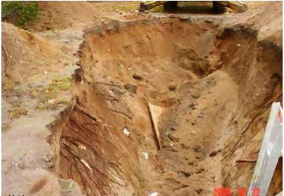
Example
Cave-in
This image courtesy of NIOSH Michigan
Notes:
This trench has no cave-in protection-spoil too close to edge, no sloping, benching, shoring, or shielding and it is a cave-in waiting to happen

Slide 28
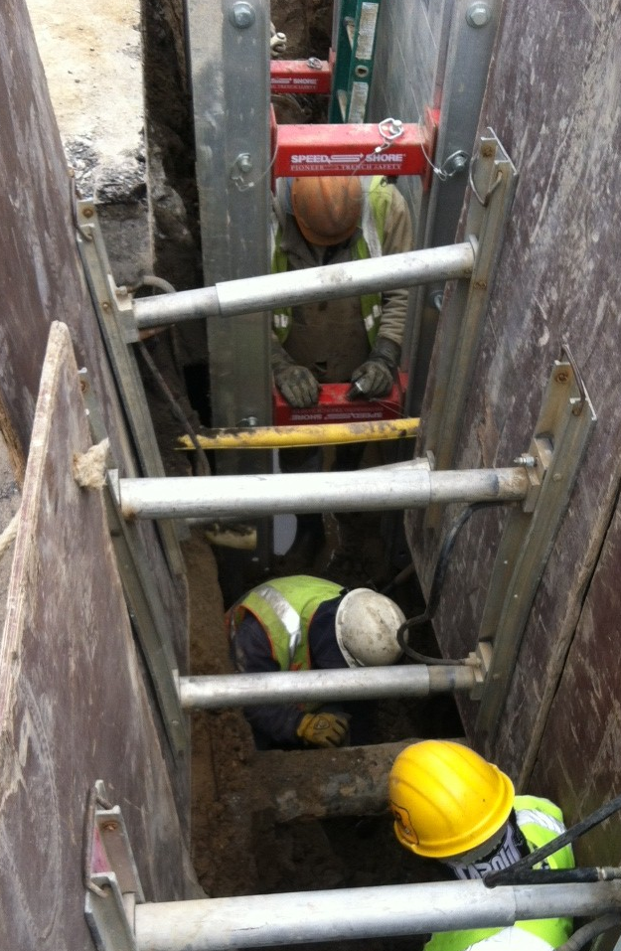
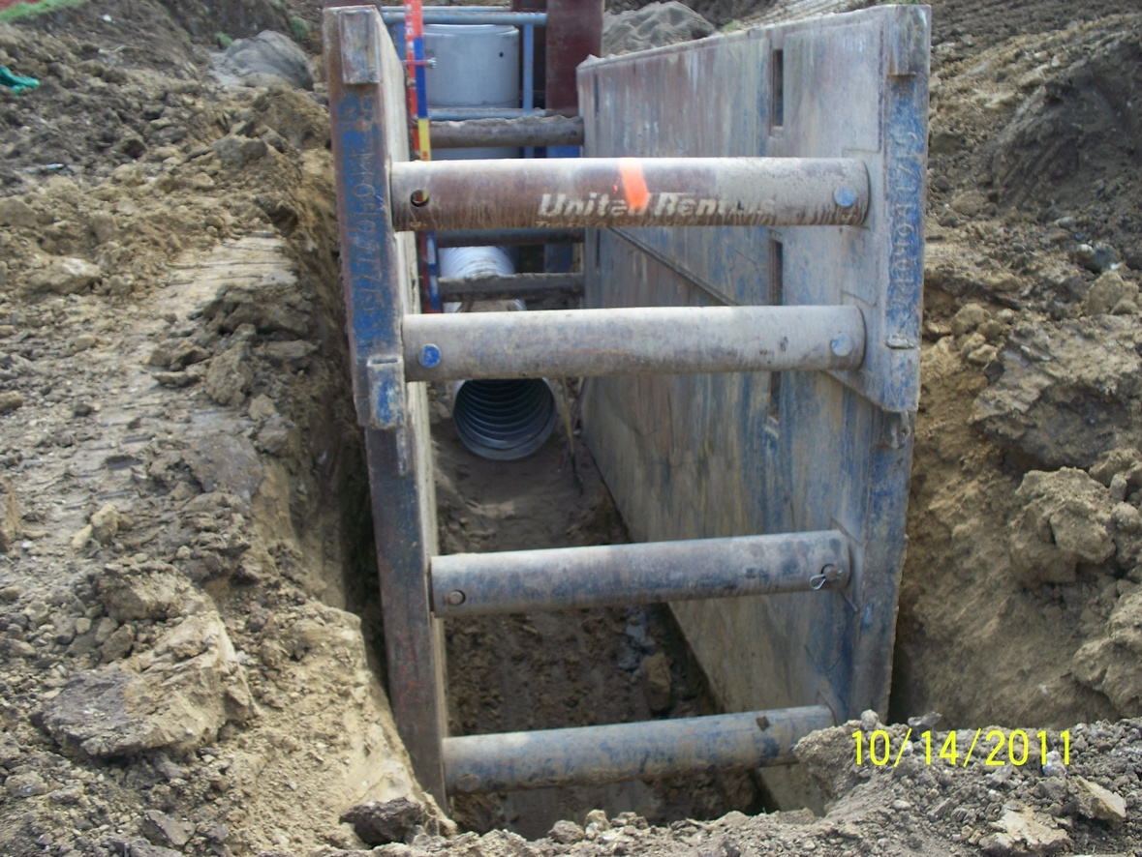
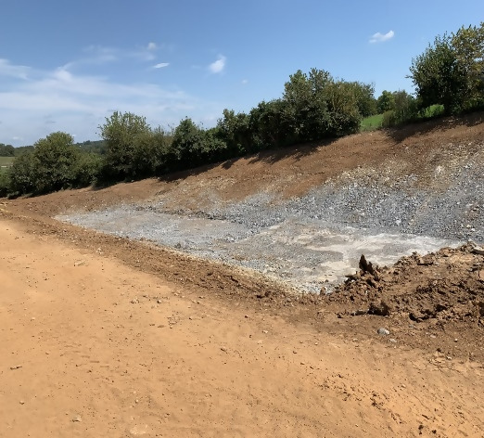
Protective Systems
Shoring
Shielding
Sloping
Notes:
Left photo-an example of sloping the walls/faces of an excavation to eliminate the potential for cave-ins.
Photo used with permission from Benjamin Yaney.
Center photo-an example of shielding, using a trench box to protect the workers inside from the walls caving-in.
Shielding photo credit – David Ponder.
Right photo-an example of hydraulic shoring. Its purpose is bracing the walls of a trench excavation to support them, so they don’t cave-in.
Shoring photo credit – David Ponder.

Slide 29

Protective Systems
This image courtesy of OSHA.
Notes:
This image depicts sloping and shielding/shoring in an easy to remember fashion.

Slide 30
Definition
Sloping:
  method of protecting employees from cave-ins by excavating to form sides of an excavation that are inclined away from the excavation so as to prevent cave-ins.
Notes:
Sloping-This definition is from OSHA. OSHA also says about sloping that “the angle of incline required to prevent a cave-in varies with differences in such factors as the soil type, environmental conditions of exposure, and application of surcharge loads.”

Slide 31
Definition
Shoring:
  a structure such as a metal hydraulic, mechanical or timber shoring system that supports the sides of an excavation and which is designed to prevent cave-ins.

Slide 32
Definition
Shield:
  a structure that is able to withstand the forces imposed on it by a cave-in and thereby protect employees within the structure.

Slide 33
Definition
Benching:
  method of protecting employees from cave-ins by excavating the sides of an excavation to form one or a series of horizontal levels or steps.

Slide 34
Other Key Terms
(Refer to your workbook)
Hazardous Atmosphere
Cross Brace
Support System
Upright
Wales
Kickout
Notes:
Hazardous atmosphere-This definition is from OSHA. An example of a hazardous atmosphere would be carbon monoxide from vehicle or fueled equipment exhaust.
Cross Brace- the horizontal members of a shoring system installed perpendicular to the sides of the excavation, the ends of which bear against either uprights or wales.
Protective system-This definition is from OSHA. OSHA also says that “Protective systems include support systems, sloping and benching systems, shield systems, and other systems that provide the necessary protection.”
Support System- a structure such as underpinning, bracing, or shoring, which provides support to an adjacent structure, underground installation, or the sides of an excavation.
Upright- the vertical members of a trench shoring system placed in contact with the earth and usually positioned so that individual members do not contact each other. Definition is from OSHA.
Wales- horizontal members of a shoring system placed parallel to the excavation face whose sides bear against the vertical members of the shoring system or earth. Definition is from OSHA.
Kickout- the accidental release or failure of a cross brace.

Slide 35
Other Key Terms Continued
(Refer to your workbook)
Failure
Face
Stable Rock
Structural Ramp
Notes:
Failure- the breakage, displacement, or permanent deformation of a structural member or connection so as to reduce its structural integrity and its supportive capabilities. Definition is from OSHA.
Face-the vertical or inclined earth surfaces formed as a result of excavation work. Definition is from OSHA.
Stable Rock- natural solid mineral material that can be excavated with vertical sides and will remain intact while exposed. -This definition is from OSHA. OSHA also says, “unstable rock is considered to be stable when the rock material on the side or sides of the excavation is secured against caving-in or movement by rock bolts or by another protective system that has been designed by a registered professional engineer.”
Structural Ramp- A ramp built of steel or wood, usually used for vehicle access. This definition is from OSHA. OSHA also says, “ramps made of soil or rock are not considered structural ramps.”

Slide 36
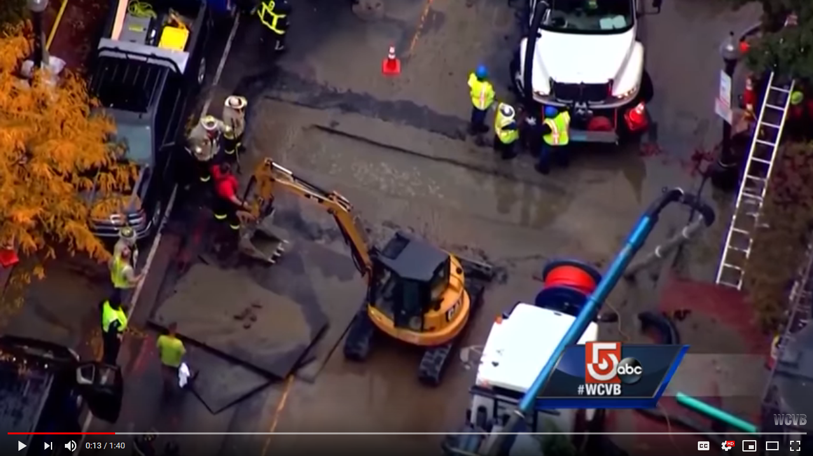
Statistics & Data
Review YouTube clip
Trenching Fatalities Between 2013-2017
  Industrial construction sites (45)
  Private residences (39)
  Street and highway construction sites (28)
Fatal Boston trench collapse
Video Courtesy of WCVB Channel 5 Boston
Notes:
This data was pulled from the Bureau of Labor Statistics and shows the number of fatalities in construction trenching and excavation work from 2013 to 2017. The hyperlinked video features a fatal trench collapse in Boston. Video courtesy of WCVB Channel 5 Boston.

Slide 37
Statistics & Data
Citations & costs:
Standard | # of Citations | Penalty Amount
1926.651 Specific Excavation Requirements | 795 | $3.4M
1926.652 Requirements of Protective Systems | 613 | $4.2M
This data courtesy of OSHA (cited by Federal OSHA during the period October 2018 through September 2019. Penalties shown reflect current rather than initial amounts.)
Notes:
This table shows the direct cost to employers for not following regulations in 1926.651 and 652-over $7.5M! This is but one aspect of cost when it comes to unsafe trench and excavation work. Other costs include:
Medical costs for injuries
Additional labor and training after an injury
Lost productivity, morale
Increased overhead
Insurance costs
Lost earnings

Slide 38
Non-fatal Injury Types:
Avulsion
Concussion
Crushing Injury
Cut, laceration
Joint Dislocation
Fracture
Internal injuries
Intracranial
Puncture
Soreness
Pain
Traumatic
Notes:
This list from OSHA’s online severe injury reports specifies 12 different types of injuries reported from trench and excavation work in 81 serious injuries since 2015. The most commonly occurring are fractures, then soreness, traumatic, internal and concussion injuries.

Slide 39
Non-fatal Injury Events:
Cave-in
Fall through surface
Fall to lower level
Fall from collapsing structure
Fall on same level
Slipping
Jump over or to a location
Notes:
This list from OSHA’s online severe injury reports show 7 different types of events that led to 81 serious injuries since 2015. All events have to do with walking/working surfaces or cave-ins. A fall into a trench that is 6 ft. or deeper is also a fall to lower level injury. It is safe to assume that some falls from heights or onto lower levels and some falls into excavations are placed into only one of the categories, thus showing less occurrence in records than.
Looking at the numbers, from 2015-2017 there averaged a little over 20 fatalities while there averaged a little under 20 serious injuries per year. What that tells us is that cave-in and falling hazards should always be corrected because over half the serious injuries are likely to result in death.

Slide 40
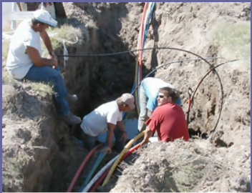
Identifying Hazards
Underground utilities
  Natural gas
  Sewer
  Water
  Electric
  Communication
  Stormwater
This image courtesy of OSHA.
Notes:
Underground utilities-damaged underground utilities can be costly and slow to repair and can carry some of the following hazards:
Natural gas-explosive, flammable, displaces oxygen
Sewer-toxic
Water-weakens excavation walls, is a drowning hazard, can impede egressing the trench
Electric-electrocution
Communication-electrocution
Stormwater-can hamper erosion control, is a drowning hazard, and may carry chemicals
Photo-trench work with multiple utilities. This photo shows some poor practices such as a lack of PPE, ladder, and cave-in protection.

Slide 41
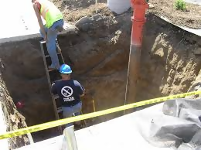
Identifying Hazards
Access & egress
No close evacuation during emergencies
Slipping, tripping or falling
Entrance or exit ramp improperly designed
Equipment entering or leaving
This image courtesy of MNOSHA.
Notes:
Access & egress-not having a safe way into or out of an excavation is a hazard.
If workers need to evacuate an excavation, their exit cannot be too far away because it would take too long for them to get out.
Workers cannot be expected to climb out of a trench using the walls, utilities or other equipment-they could easily trip, slip or fall and get injured.
If the means of entrance or exit is not designed correctly and fails, workers could get crushed or pinned by soil or equipment

Slide 42
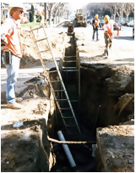
Identifying Hazards
Equipment & vehicular traffic
Accidental vehicle entry
Falling loads
Struck while loading or unloading
This image courtesy of OSHA.
Notes:
Equipment & vehicular traffic-vehicles around trenches and excavations are also hazards. This may include traffic as well as equipment on the job site.
Any vehicle accidentally entering a trench or excavation is bad for the driver and anyone working in the area.
Soil, rocks or other debris that is removed from the excavation can fall and cause injuries to workers nearby.
Many times, it can be difficult for equipment operators to be aware of who is in their work area because they are focused on what they are working on, so struck by digging, loading or unloading operations exist.

Slide 43
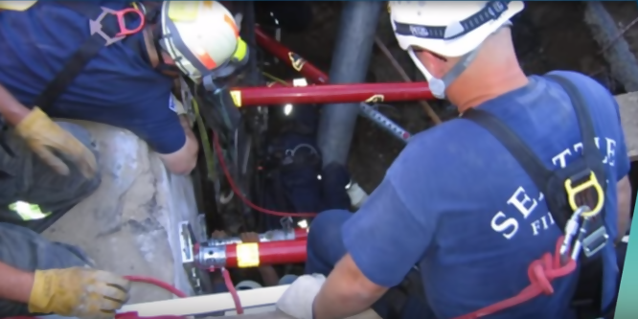
Identifying Hazards
Hazardous atmosphere
Lack of oxygen
Flammable, explosive or toxic air
Lack of rescue equipment
This image courtesy of CPWR.
Notes:
Hazardous atmosphere-vapors, dust or fumes in the air can displace oxygen, be toxic to breathe or may ignite and burn or explode. Knowing what might be in the atmosphere will help workers know what hazards might exist. If hazardous atmospheres are present, a lack of rescue plan or equipment is a hazard as well. Untrained or unprepared rescuers entering an excavation might get injured or stuck themselves, increasing the need for more rescuers.

Slide 44
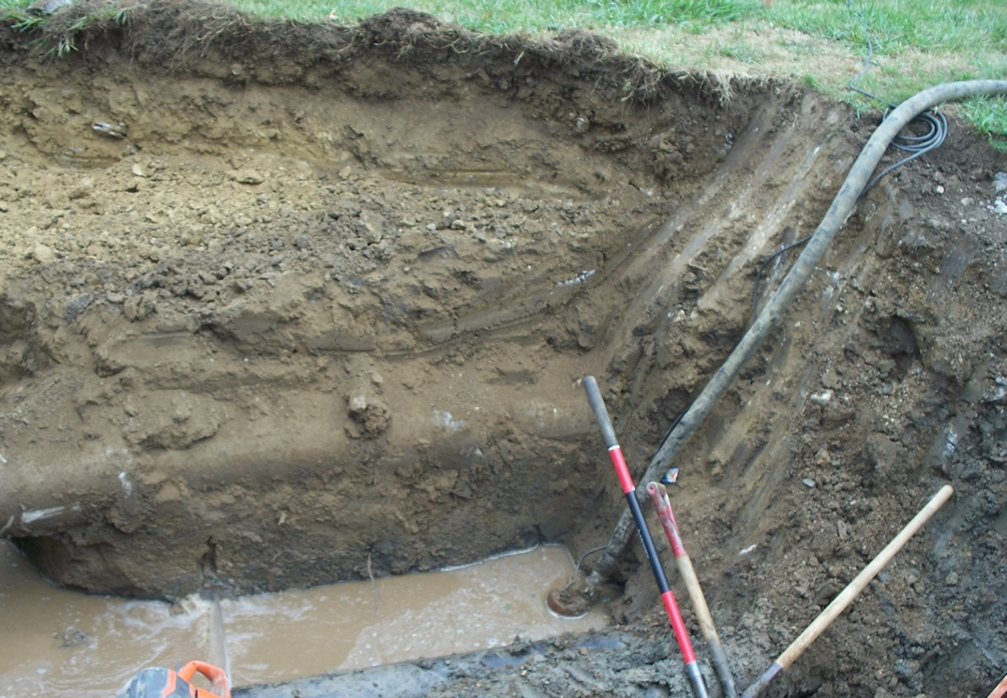
Identifying Hazards
Water accumulation
Drowning hazard
Slipping hazard
Electrical
Egress and stability hazard
Notes:
Water accumulation-excavations with accumulated or accumulating water or that are saturated are hazardous for workers.
If the water is deep enough, workers could drown if they fall, get stuck or can’t swim.
Wet work areas always have slip hazards, and especially in trenches and excavations due to the uneven ground and likelihood of slick surfaces.
Water in an excavation may cause electrical tools and equipment to short out or not be sufficiently grounded, which are risks to workers.
Saturated soil can impede workers from exiting an excavation. It also has less supportive strength and can cause walls or other features to fail.

Slide 45
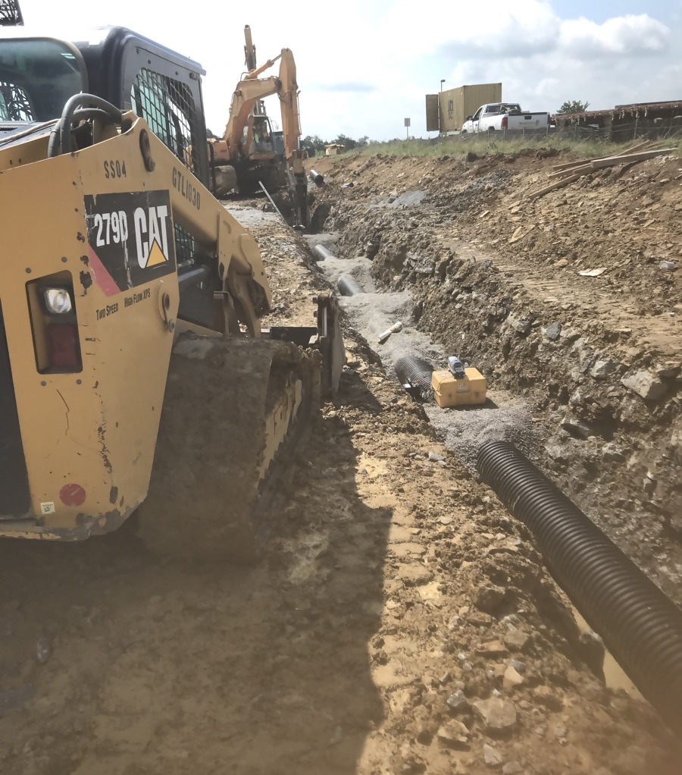
Identifying Hazards
Stability
Loose soil or rock along edges
Surface encumbrances
Cave-ins
Notes:
Stability-there are inherent stability hazards in every excavation just due to the nature of digging in the ground.
Loose soil or rocks along the edges of excavations can fall and injure workers below.
Surface encumbrances are any nearby structures that can become unstable due to the excavation-this can include trees, sidewalks, utility poles, or buildings for example. If any of those were to fall, slide, break or move unintentionally then workers nearby could get hurt.
Cave-ins are generally the most serious hazard associated with excavations and trenches.

Slide 46
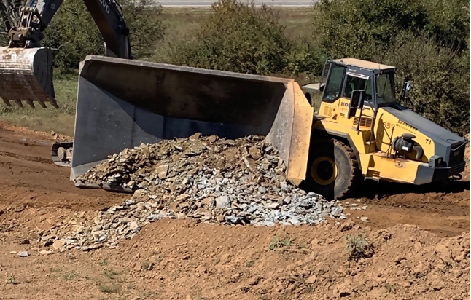
Identifying Hazards
Unsafe behaviors
Poor equipment operation
Overconfidence
Resistant to change
Ignorant of hazard severity
Notes:
Workers, even with good intentions can make bad decisions themselves or have bad habits or attitudes that are hazardous. These may include poor operation of equipment, exhibiting overconfidence in ability or feeling like hazards or exposure doesn’t apply to them, being resistant to change from the way they have always done things, or just not knowing how serious a hazard is and thus ignoring it.

Slide 47
Workshop A
Hazard Identification

Slide 48
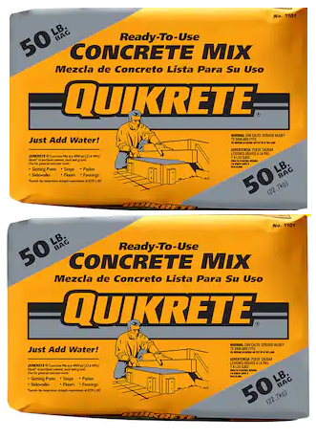

Soil Mechanics
-1 cubic foot of soil
-1 cubic yard of soil
-about 100 lb.
-about 2700 lb.
These images are courtesy of creative commons.
Notes:
Soil weighs more than people typically think. 1 cubic foot of soil weighs about 100 pounds, or about as much as two bags of concrete mix. When an excavator is digging, buckets can often reach capacities of soil over 27 cubic feet (1 cubic yard)-that’s around 2700 lb. of dirt, or about the same weight as a Mini Cooper. That is a lot of crushing force.

Slide 49
Soil Mechanics
Failures
Fissured
  soil material that has a tendency to break along definite planes of fracture with little resistance, or a material that exhibits open cracks, such as tension cracks, in an exposed surface.
Notes:
Fissured means a soil material that has a tendency to break along definite planes of fracture with little resistance, or a material that exhibits open cracks, such as tension cracks, in an exposed surface. Observe the side of the opened excavation and the surface area adjacent to the excavation. Crack-like openings such as tension cracks could indicate fissured material. If chunks of soil spall off a vertical side, the soil could be fissured. Small spalls are evidence of moving ground and are indications of potentially hazardous situations

Slide 50
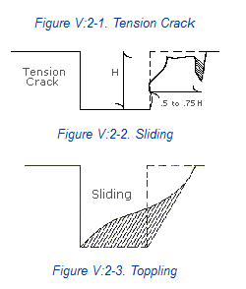
Soil Mechanics
Failures
These images courtesy of OSHA.
Notes:
Failures-A tension crack can cause soil to slide into an excavation. These cracks tend to happen at a distance ½ to ¾ of the depth of the excavation horizontally

Slide 51
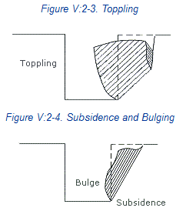
Soil Mechanics
Failures
These images courtesy of OSHA.
Notes:
Failures-Tension cracks may cause a shear break in the soil, causing it to topple into the excavation. Unbalanced stress in the soil can cause it to bulge into the excavation as well

Slide 52
Competent Person
  one who is capable of identifying existing and predictable hazards in the surroundings…and who has authorization to take prompt corrective measures to eliminate them.
Notes:
Competent Person-This definition is from OSHA. OSHA also says that a competent person can identify “working conditions which are unsanitary, hazardous, or dangerous to employees.” The employer is responsible to have and designate the competent person.

Slide 53
Competent Person
Role & responsibilities:
Design structural ramps used for workers only
Monitor water removal operations
Inspection prior to work and during shift
Remove workers exposed to hazardous area
Take precautions for worker safety
Notes:
Role-A competent person is designated by the employer and must be capable of 4 broad actions and have 1 broad authorization.
1-identify existing hazards
2-identify predictable hazards
3-identify hazardous working condition
-and be authorized to correct them all. Every trench or excavation site needs to have a competent person put their eyes on it at least once to perform their responsibilities.
Responsibilities-A competent person must inspect the site and protective systems daily for evidence of anything that could possibly cause a cave-in, failure of protective systems, hazardous atmosphere or another hazard. When hazards are found, they need to remove workers from them and take appropriate precautions before workers continue work. When water is being removed, they must specifically monitor water removal operations and equipment. They are also the one to design all structural ramps (steel or wood construction) for worker access only. If vehicles will use the ramp, a competent person in structural design must design the ramps.

Slide 54
Competent Person
Role & responsibilities:
Examine ground of <5 ft. excavations
Examine damaged equipment used in protective systems
Classify and reclassify soil & rock
Reduce maximum slope based on surcharge loads
Evaluate the effects of surcharge
Notes:
Responsibilities-A competent person can determine that an excavation less than 5 ft. in depth does not need a protective system after examining the ground. They are also expected to determine if damaged components of shoring or shielding are suitable for use or not. Another duty they have is to reduce the maximum slope in a sloping protective system if there are additional loads placed on the soil from equipment and other nearby structures. A final major responsibility of theirs is to classify soil and rock deposits and reclassify them if conditions affecting their classification change in any way

Slide 55
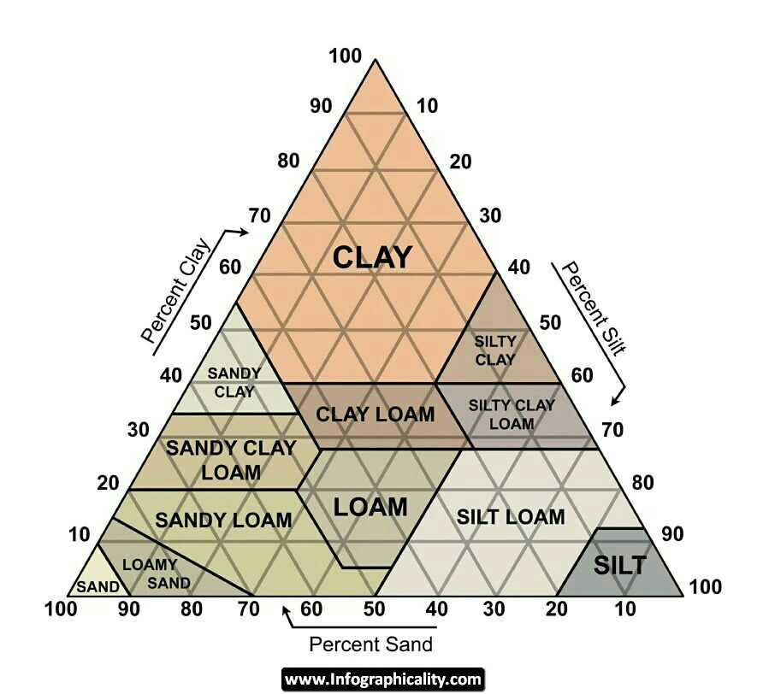
Soil Classification
Classifications:
Stable rock
Type A
Type B
Type C
USDA Soil Texture Calculator (link)
Notes:
OSHA classifications-OSHA classifies soil as one of the following:
-Stable rock
-Type A (cohesive with unconfined compressive strength > 1.5 tons/sq. ft.). Examples include clay, silty clay, sandy clay and clay loam.
-Type B (cohesive with unconfined compressive strength between 0.5 and 1.5 tons/sq.ft.). Examples include silt, silt loam, sandy clay loam, silty clay loam and angular gravel.
-Type C (cohesive with unconfined compressive strength less than 0.5 tons/sq. ft.). Examples include gravel, sand, loamy sand or sandy loam and soil with freely seeping water.
OSHA requires at least one visual test and one manual test be performed by the competent person before classifying soil. It is a good idea to document the soil classification each time it is made, including what tests were used and the results of each.
The chart shown is from the United States Department of Agriculture and depicts soil classifications with percent sand, silt and clay along the three sides. The link will take you the USDA Soil Texture Calculator

Slide 56
Type A Soil
Undisturbed
Stable
Cohesive = Clay
  Silty Clay
  Sandy Clay
  Clay Loam
  Silty Clay Loam
  Sandy Clay Loam
Cohesive with unconfined compressive strength > 1.5 tons/sq. ft.
Notes:
Type A soil is cohesive and has a high unconfined compressive strength; 1.5 tons per square foot or greater. Examples of type A soil include clay, silty clay, sandy clay, and clay loam

Slide 57
Type A Soil (cont.)
Uncommon
No Soil is Type A if:
  Soil has been previously disturbed
  Soil is fissured
  Soil is subject to vibration from heavy traffic, pile driving, or similar effects
Notes:
Soil cannot be classified as type A if it is fissured, if it has been previously disturbed, if it has water seeping through it, or if it is subject to vibration from sources such as heavy traffic or pile drivers

Slide 58
Type B Soil
Cohesive with unconfined compressive strength between 0.5 and 1.5 tons/sq.ft.
Previously disturbed
Granular cohesionless soils (crushed rock)
Soil that meets the unconfined compressive strength or cementation requirements for Type A, but is fissured or subject to vibration; or
Dry rock that is not stable; or
Material that is part of a sloped, layered system where the layers dip into the excavation on a slope less steep than four horizontal to one vertical (4H:1V), but only if the material would otherwise be classified as Type B.
Notes:
Type B soil is cohesive and has often been cracked or disturbed, with pieces that don't stick together as well as Type A soil. Type B soil has medium unconfined compressive strength; between 0.5 and 1.5 tons per square foot. Examples of Type B soil include angular gravel, silt, silt loam, and soils that are fissured or near sources of vibration, but could otherwise be Type A

Slide 59
Type C Soil
Granular
Gravel
Sand
Submerged soil or soil from which water is freely seeping
Cohesive with unconfined compressive strength less than 0.5 tons/sq. ft.
Notes:
Type C soil is the least stable type of soil. Type C includes granular soils in which particles don't stick together and cohesive soils with a low unconfined compressive strength; 0.5 tons per square foot or less. Examples of Type C soil include gravel, and sand. Because it is not stable, soil with water seeping through it is also automatically classified as Type C soil, regardless of its other characteristics

Slide 60
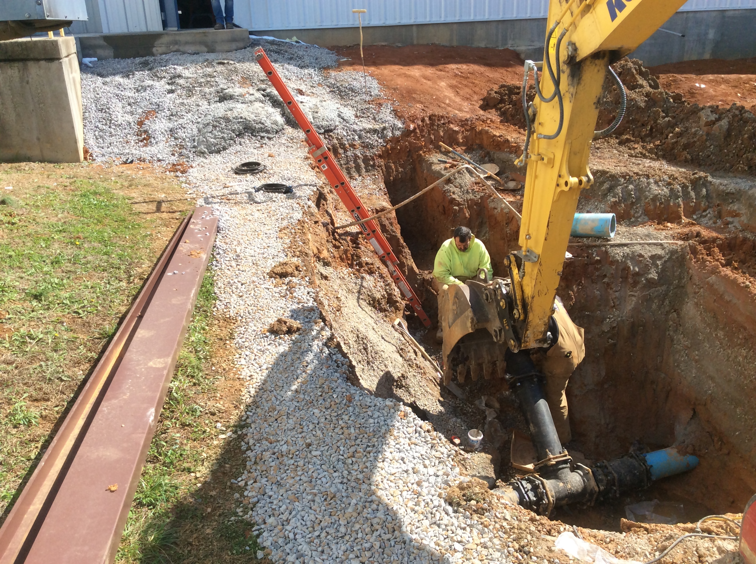
Soil Testing
Visual tests:
Grain
Clumps vs. breaks easily
Fissured material
Previously disturbed
Layers
Water
Vibration
Notes:
Visual tests. Visual analysis is conducted to determine qualitative information regarding the excavation site in general, the soil adjacent to the excavation, the soil forming the sides of the open excavation, and the soil taken as samples from excavated material.
(i) Observe samples of soil that are excavated and soil in the sides of the excavation. Estimate the range of particle sizes and the relative amounts of the particle sizes. Soil that is primarily composed of fine-grained material is cohesive material. Soil composed primarily of coarse-grained sand or gravel is granular material.
(ii) Observe soil as it is excavated. Soil that remains in clumps when excavated is cohesive. Soil that breaks up easily and does not stay in clumps is granular.
(iii) Observe the side of the opened excavation and the surface area adjacent to the excavation. Crack-like openings such as tension cracks could indicate fissured material. If chunks of soil spall off a vertical side, the soil could be fissured. Small spalls are evidence of moving ground and are indications of potentially hazardous situations.
(iv) Observe the area adjacent to the excavation and the excavation itself for evidence of existing utility and other underground structures, and to identify previously disturbed soil.
(v) Observed the opened side of the excavation to identify layered systems. Examine layered systems to identify if the layers slope toward the excavation. Estimate the degree of slope of the layers.
(vi) Observe the area adjacent to the excavation and the sides of the opened excavation for evidence of surface water, water seeping from the sides of the excavation, or the location of the level of the water table.
(vii) Observe the area adjacent to the excavation and the area within the excavation for sources of vibration that may affect the stability of the excavation face.
Photo-this photo shows that existing underground utilities were uncovered, so the soil must have been previously disturbed when they were put in

Slide 61
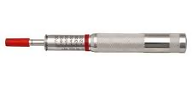
Soil Testing
Manual tests:
Dry strength
Plasticity
Thumb penetration
Pencil Test
Pocket Penetrometer
This image courtesy of creative commons.
Notes:
Manual tests. Manual analysis of soil samples is conducted to determine quantitative as well as qualitative properties of soil and to provide more information in order to classify soil properly.
(i) Plasticity. Mold a moist or wet sample of soil into a ball and attempt to roll it into threads as thin as 1/8-inch in diameter. Cohesive material can be successfully rolled into threads without crumbling. For example, if at least a two inch (50 mm) length of 1/8-inch thread can be held on one end without tearing, the soil is cohesive.
(ii) Dry strength. If the soil is dry and crumbles on its own or with moderate pressure into individual grains or fine powder, it is granular (any combination of gravel, sand, or silt). If the soil is dry and falls into clumps which break up into smaller clumps, but the smaller clumps can only be broken up with difficulty, it may be clay in any combination with gravel, sand or silt. If the dry soil breaks into clumps which do not break up into small clumps and which can only be broken with difficulty, and there is no visual indication the soil is fissured, the soil may be considered unfissured.
(iii) Thumb penetration. The thumb penetration test can be used to estimate the unconfined compressive strength of cohesive soils. (This test is based on the thumb penetration test described in American Society for Testing and Materials (ASTM) Standard designation D2488 - "Standard Recommended Practice for Description of Soils (Visual - Manual Procedure).") Type A soils with an unconfined compressive strength of 1.5 tsf can be readily indented by the thumb; however, they can be penetrated by the thumb only with very great effort. Type C soils with an unconfined compressive strength of 0.5 tsf can be easily penetrated several inches by the thumb, and can be molded by light finger pressure. This test should be conducted on an undisturbed soil sample, such as a large clump of spoil, as soon as practicable after excavation to keep to a minimum the effects of exposure to drying influences. If the excavation is later exposed to wetting influences (rain, flooding), the classification of the soil must be changed accordingly.
(iv) Other strength tests. Estimates of unconfined compressive strength of soils can also be obtained by use of a pocket penetrometer or by using a hand-operated shearvane.
(v) Drying test. The basic purpose of the drying test is to differentiate between cohesive material with fissures, unfissured cohesive material, and granular material. The procedure for the drying test involves drying a sample of soil that is approximately one inch thick (2.54 cm) and six inches (15.24 cm) in diameter until it is thoroughly dry:
(A) If the sample develops cracks as it dries, significant fissures are indicated.
(B) Samples that dry without cracking are to be broken by hand. If considerable force is necessary to break a sample, the soil has significant cohesive material content. The soil can be classified as an unfissured cohesive material and the unconfined compressive strength should be determined.
(C) If a sample breaks easily by hand, it is either a fissured cohesive material or a granular material. To distinguish between the two, pulverize the dried clumps of the sample by hand or by stepping on them. If the clumps do not pulverize easily, the material is cohesive with fissures. If they pulverize easily into very small fragments, the material is granular

Slide 62
Workshop B
Soil Testing

Slide 63
Safety Program
Job Hazard Analysis (JHA)
Sections:
Job steps
Potential hazards
Critical actions to mitigate hazards
Minimum required PPE
Job Hazard Analysis (JHA)
COMPANY/ PROJECT NAME or ID/ LOCATION ( City, State) |  | DATE | NEW REVISED |  |  | PAGE 1 of 3
WORK ACTIVITY (Description): Excavation & Trenching
DEVELOPMENT TEAM | POSITION / TITLE | REVIEWED BY: |  | POSITION / TITLE
 | Safety Manager |  |  | Sr. Project Manager
 | Site Manager
 | Project Engineer
MINIMUM REQUIRED PERSONAL PROTECTIVE EQUIPMENT ( SEE CRITICAL ACTIONS FOR TASK-SPECIFIC REQUIREMENTS)
REFLECTIVE VEST HARD HAT LIFELINE / HARNESS SAFETY GLASSES | GOGGLES FACE SHIELD HEARING PROTECTION SAFETY SHOES | AIR PURIFYING RESPIRATOR SUPPLIED RESPIRATOR PPE CLOTHING |  |  | GLOVES Cut-resistant OTHER Chaps
¹JOB STEPS | ²POTENTIAL HAZARDS | ³CRITICAL ACTIONS TO MITIGATE HAZARDS
underground drawings and excavation permit | Underground utilities, footings, or foundations are not identified they may be damaged during excavation, causing property damage, personal injury, or accidentally shutting down vital plant processes causing potential shut down of unit or units | Call 811 for utility checks and marking (811 will not locate local water lines) Attains and understands drawings identifying underground structures in the excavation location including sewers, oily water and storm water, firewater, service water, potable water, electrical, product lines, and/or natural gas mains, pipelines, etc., foundations and footings and share this information with all employees on job during pre-job planning and toolbox meetings, to ensure excavations will not damage under-ground utilities or lines or affect the stability of any surrounding buildings, vessels, or structures

Slide 64

Safety Program
Inspections
Inspect for:
Hazards
Access & egress
Confined spaces
PPE
Housekeeping
This Photo by Unknown Author is licensed under CC BY
This image courtesy of creative commons.
Notes:
Inspections-Inspections are a necessary part of a good safety program as well. Some inspections can be performed by any worker if they are trained in what to inspect for and how to do it. These would include general items such as hazards, access & egress, confined spaces, PPE, and housekeeping. Having a checklist that details what to look for and examples of safe or unsafe observations makes it simple and clear for the person doing the inspecting. Then there also needs to be a system for turning in the inspection and addressing any findings. It is also a good idea to sign or initial the checklist and keep it on file just in case it is needed.
Image credit-creative commons

Slide 65

Safety Program
Inspections
Inspect for:
Failure of protective systems
Accumulated water/soil moisture
Cracks, sloughing, bulging
This Photo by Unknown Author is licensed under CC BY-SA
This image courtesy of creative commons.
Notes:
Inspections-Certain inspections must be performed by a competent person, and these are some that a competent person in excavations and trenches would need to perform: failures in protective systems, accumulated water and soil moisture, and evidence of cave-in potential such as cracking, bulging or sloughing soil. We discuss more responsibilities of a competent person later in this presentation.

Slide 66
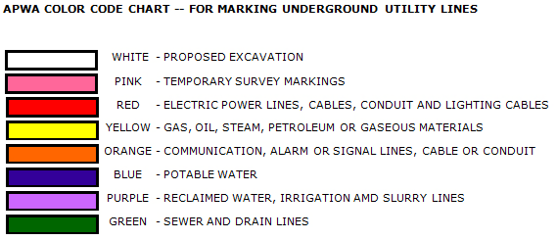
Abating Hazards
Locating and protecting utilities
Call 811 and have utilities marked
Use other detection methods (eg. “potholing”)
Support/protect once uncovered
This image courtesy of MN Department of Public Safety
Notes:
Locating utilities--to prevent damage to underground installations, follow these three steps:
Have utility companies locate and mark the utilities in the area where work is proposed. A good practice is to paint a white line around the area where the earth will be moved to ensure it is located.
If they cannot be located or marked, “pot hole” or use other detection methods to locate the utility. Pot holing is digging a small hole carefully and incrementally to find an underground utility that hasn’t been marked or had its location verified. Once uncovered, the location can be extrapolated. It may take multiple pot holes to accomplish this.
When a utility is uncovered and inside an excavation, it must be supported, protected or removed as necessary to ensure worker safety.

Slide 67
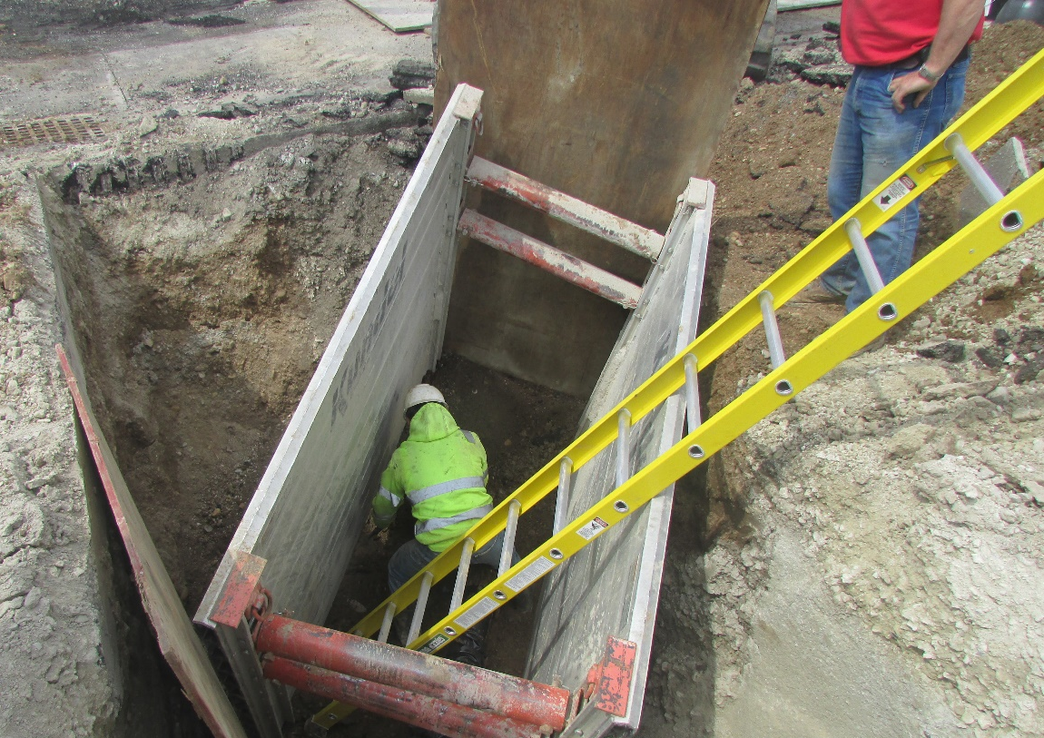
Abating Hazards
Ladders and ramps
Exits located within 25 lateral feet
Ladders secured and extended
Ramps designed by competent person
Internal traffic control plan
Notes:
Slide 67: Abating Hazards
Ladders and ramps-proper ladder placement, ramp design and internal traffic control will eliminate many access and egress hazards.
All egress points must be located so that an employee in any part of the trench can reach one within 25 ft. of lateral movement. Ladders must be secured and extend at least 3 ft. above the excavation. Extension ladders are typically the main ladder style used. If a ramp is used for equipment, it must be designed by a competent person qualified in structural design and there should be a traffic control plan if it will also be used by pedestrians. A traffic control plan will designate a location or time for pedestrians that is separate from vehicles or provide full-time spotters to ensure safe vehicle movement

Slide 68
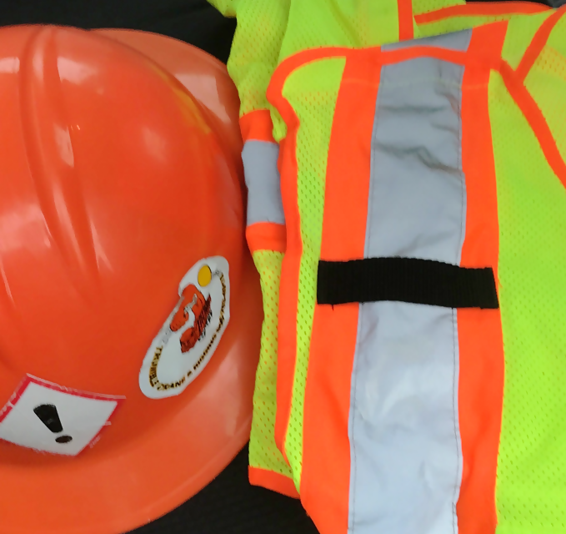
Abating Hazards
Exposure controls & warning systems (concerning vehicles & equipment)
High viz clothing
Flag person, signs, barricades
Nobody permitted under loads
Edge barricades, stop logs, etc.
Notes:
Exposure control and warning systems-these methods will reduce hazards for workers that come from traffic and equipment.
If an excavation is in a traffic area, workers must wear high visibility, reflective clothing. If the trench or excavation reroutes traffic, then a proper flagger, signs, and barricades designated in the Manual on Uniform Traffic Control Devices (MUTCD) must be in place to do so safely. The individuals flagging or directing traffic must always be alert and aware and should excel in clear nonverbal communication.
No workers are permitted underneath digging and excavating loads. It is best if both the workers on the ground and in the equipment strictly enforce this policy. Also, barricades or stop devices such as logs, berms, etc. must be in place along the edge of an excavation if operators do not have a clear view of the edge. This is a good practice even when operators can see the edge clearly.

Slide 69
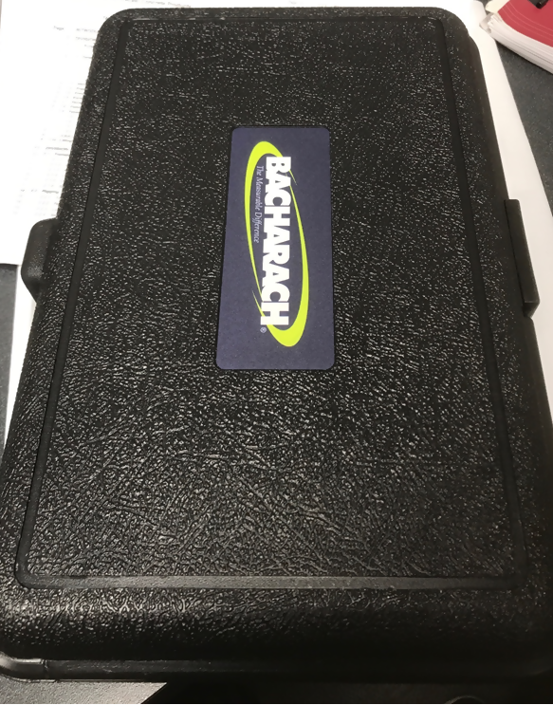
Abating Hazards
Testing and controls (concerning atmospheres)
Test for:
Oxygen
Flammables
Toxic substance
Control via:
Ventilation
Respirators
Rescue
Notes:
Testing and controls-verifying what is present in an excavation atmosphere and controlling exposure to it helps workers avoid potential hazards.
A four-gas monitor is a good testing device to determine if there is lack of oxygen or presence of common flammable or toxic fumes in an atmosphere. Often, ventilation in the form of air movers is enough to remove the bad stuff and supply fresh air. If more protection is needed, workers will need to wear respirators to keep them from breathing the fumes or to supply fresh air if necessary. When a hazardous atmosphere exists, rescue equipment and trained personnel must be available and prepared to perform rescues for workers in the excavation

Slide 70
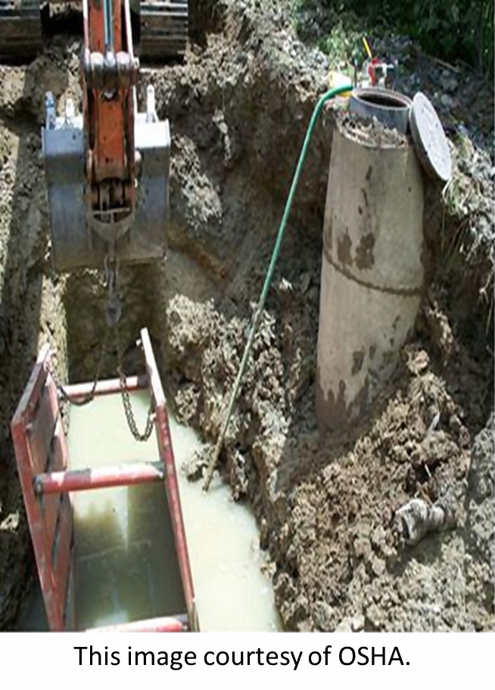
Abating Hazards
Dealing with water
Pump it out
Naturally dry out
Protection for electrical
Notes:
Dealing with water-water accumulation in an excavation brings a few hazards with it.
Water can often be pumped out of an excavation to get rid of the drowning hazard, but it is likely that slip hazards and egress hazards will remain on wet and saturated surfaces. Natural drying out of the trench is the most complete way to solve those problems. If water enters from the ground below or an unknown source, then additional investigating as to the source will need to be performed and the local waterway authority may need to be involved.
Water can also cause electrical tools and equipment to short out, but sometimes electrical components can be covered or protected with tarps, plastic or other impermeable material to keep them dry and usable

Slide 71
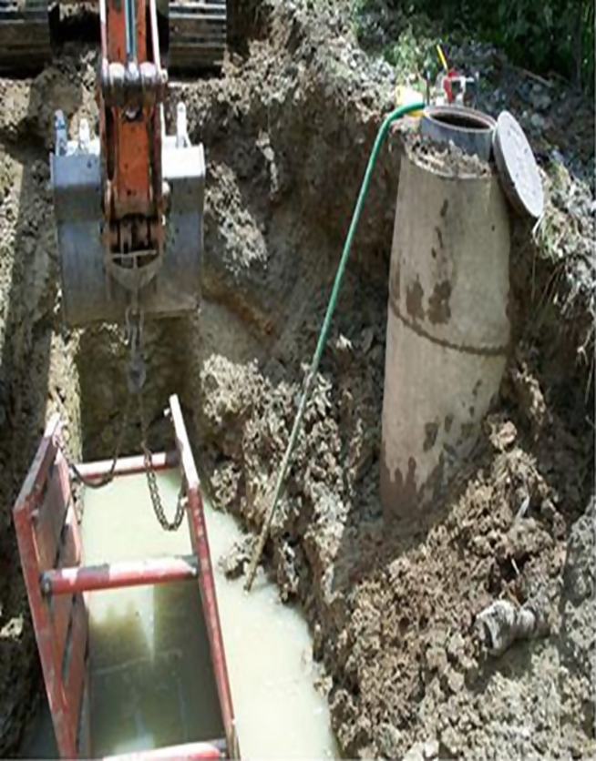
Hazards Identified within the Photo
Improper slope
Unprotected hole
Permit Required Confined Space
Trench height greater than 18” from top of box
No access or egress
Training, competent person and inspection seem to be missing
Distance from the excavation wall to the trench box is greater
than expected surcharge.
Water pooled inside the trench

Slide 72
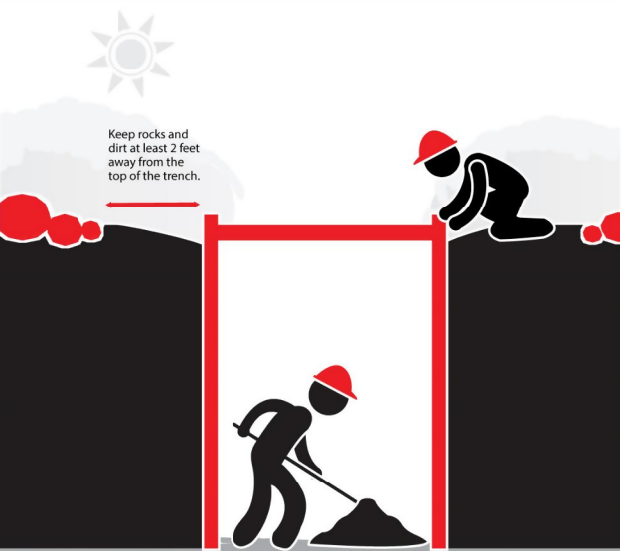
Abating Hazards
Soil support
Spoil pile location
Remove loose rocks
Support structures
Protective systems
This image courtesy of CPWR.
Notes:
Soil support-placing and supporting soil in a safe manner is essential for worker safety in excavations. One cubic foot of soil can weigh 100 lbs. and one cubic yard can weigh 2700 lbs.
It starts with placing spoil piles at least 2 ft. from the edge to reduce pressure on the excavation walls. Then, loose rocks or chunks of soil should be knocked down prior to workers entering so that they do not fall on workers. Next, structures in the area need to be supported correctly so they stay in place and do not fall. Bracing, tying down and jacking are some methods to add support to structures.
Finally, protective systems to prevent cave-ins is the most critical type of soil support. These include sloping and benching, support systems such as shoring, bracing and underpinning, as well as shielding. These are always required unless the excavation is in stable rock or less than 5 ft. depth. We will go into a little more detail on those in the next slides

Slide 73
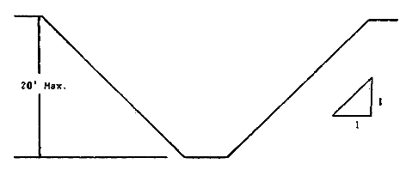
Cave-in Protection
Sloping:
3/4:1 – 1.5:1 depending on soil type
Image Courtesy of OSHA
Notes:
Sloping and benching-this technique uses geometry to reduce the likelihood of cave-ins and is good for cohesive type A or B soil. Slopes can vary from ¾:1 to 1.5:1 depending on soil type. Benching typically stays at a 1:1 ratio. These forms of protection are cost effective but do require additional space around the excavation or trench to perform.
Sloping a ten-foot-deep excavation/trench makes the area much wider, but eliminates the potential for a cave-in

Slide 74
Cave-in Protection
Maximum Allowable Slopes
Soil or Rock Type | Maximum Allowable Slopes (H:V)(1) For Excavations Less Than 20 Feet Deep(3)
STABLE ROCK TYPE A (2) TYPE B TYPE C | VERTICAL (90º) 3/4:1 (53º) 1:1 (45º) 1 ½:1 (34º)
Table Courtesy of OSHA
Notes:
Configurations of sloping and benching systems shall be in accordance with Figure B-1.
Footnote(1) Numbers shown in parentheses next to maximum allowable slopes are angles expressed in degrees from the horizontal. Angles have been rounded off.
Footnote(2) A short-term maximum allowable slope of 1/2H:1V (63º) is allowed in excavations in Type A soil that are 12 feet (3.67 m) or less in depth. Short-term maximum allowable slopes for excavations greater than 12 feet (3.67 m) in depth shall be 3/4H:1V (53º).
Footnote(3) Sloping or benching for excavations greater than 20 feet deep shall be designed by a registered professional engineer

Slide 75
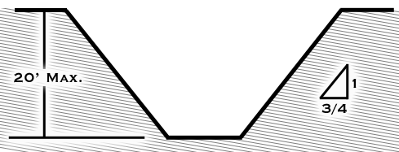
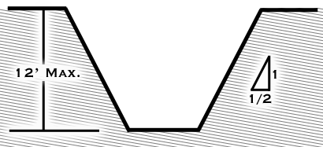
Slopes
Type A
Simple slope excavations which are open 24 hours or less (short term)
Graphics from Virginia Tech Excavation Safety
Notes:
A maximum Type A slope is represented in the graphic on the left. A short term or simple slope excavation is represented in the graphic on the right.

Slide 76
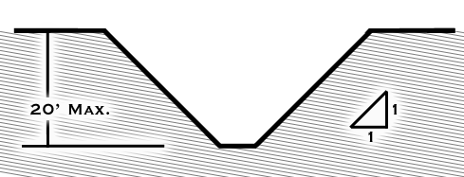
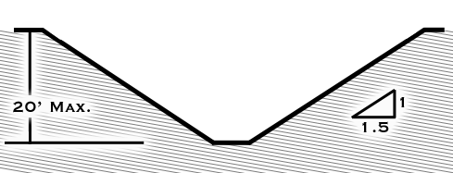
Slopes
Type B
Type C
Graphics from Virginia Tech Excavation Safety
Notes:
A maximum Type B slope is represented in the graphic on the left. A maximum Type C slope is represented in the graphic on the right

Slide 77
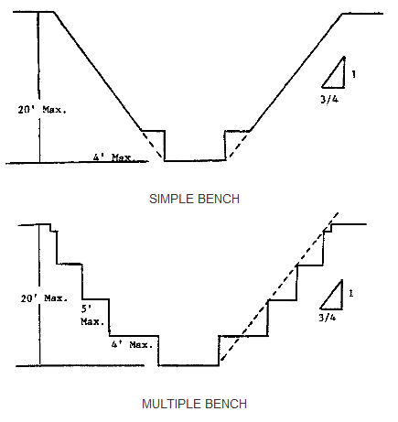
Cave-in Protection
Benching
Excavations 20 feet or less in depth shall have a maximum allowable slope of 1:1 and maximum bench dimensions as follows:
Image Courtesy of OSHA
Notes:
Benching, excavations 20 feet or less in depth shall have a maximum allowable slope of 1:1 and maximum bench dimensions as follows

Slide 78
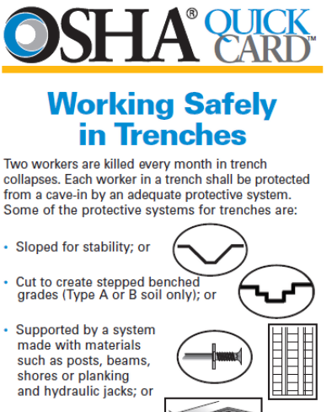
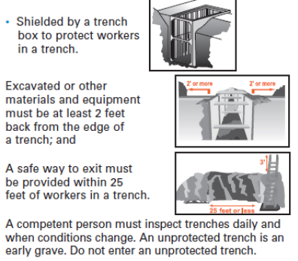
Cave-in Protection
These images courtesy of OSHA Trench Safety Tips
Notes:
Shielding-trench boxes are the primary form of shielding and are not designed to support the excavation but protect the workers inside the box from cave-ins. Trench boxes typically must be backfilled to prevent movement and if they are not large enough for the whole trench or site, must be moved often.
This equipment can be rented like other construction equipment and must be used according to manufacturer’s data as such. It is available to use other tabulated data given that it is in written form, identifies parameters that affect selection, identifies limits, explains information that affects selection and at least one copy is kept at the jobsite.
It is also available to have a registered professional engineer design the shielding system and specify materials, identify the PE, and at least one copy be kept at the jobsite

Slide 79
Preventing Cave-ins
Shoring Comparison
Timber
Aluminum Hydraulic
Specific wood requirements
More tables of specifications (12)
Labor intensive to install (2 people, heavier components)
Less labor intensive (1 person can install, lightweight)
Safer installation (install from top of trench/excavation down)
Less tables of specifications (6)
Adjustable
Time to install
Require inspection
Inventory or rent components
Notes:
Shoring-timber shoring and aluminum hydraulic shoring are designed to prevent movement of soil, roadways, foundations and utilities. All shoring must comply with the applicable tables in 1926 Subpart P Appendix C (for timber) and D (for aluminum).
Aluminum hydraulic is the best because it can be installed by one worker and they do not need to enter the trench to install it. Aluminum hydraulic is less labor intensive and has less specifications to follow from the OSHA tables. Aluminum hydraulic shoring is more technologically advanced, and it is likely that OSHA will stop allowing timber shoring in favor of aluminum hydraulic. Like many OSHA standards, manufacturers requirements must be followed to ensure it is safe to use.
All shoring needs to be inspected each day for leaks, damage, broken connections, etc

Slide 80
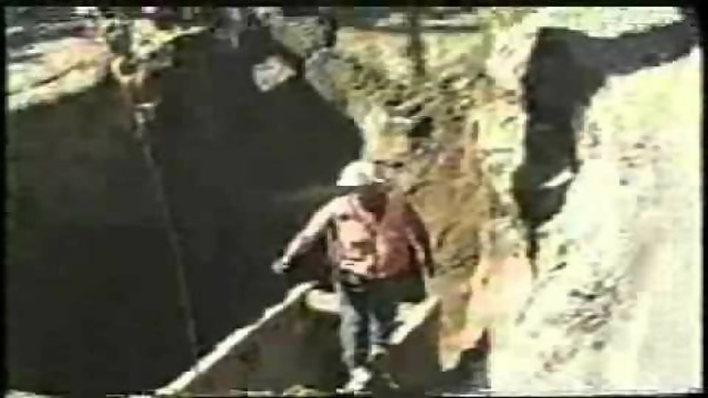
Trench Cave In
This video courtesy of Oregon OSHA.
Notes:
Speed-Gravity accelerates falling things at 9.8 meters/second each second. If a piece of earth falls from the top of a trench or excavation, it will land in about one second unless the hole is greater than 25-30 ft. That doesn’t leave much time for reaction.
This video shows how quickly dirt can cave in

Slide 81
Workshop D
Cave-ins

Slide 82
Review
  Describe worker rights
  Define key terms
  Identify excavation & trench hazards
  Describe the hazards related to soil
  Name two components of safety & health program
Notes:
Spend a few minutes reviewing materials, ensuring the learning objectives are met.

Slide 83
Review
  6. Describe how to abate various hazards
  7. Describe the responsibilities of a competent person
  8. Name and describe a few visual and manual soil tests
  9. Describe a best practice for the following:
  Sloping/benching, shoring, shielding
Notes:
Spend a few minutes reviewing materials, ensuring the learning objectives are met.

Slide 84
Let’s Test Our Knowledge
Post-class Quiz

Slide 85
Post-Assessment (Q1)
Structural ramps used solely by employees as a means of access and egress from excavations shall be designed by a:
Qualified Engineer
Competent Person
Architect
Employees
Notes:
The Answer is B

Slide 86
Post-Assessment (Q2)
2. Excavations must be inspected daily by an Authorized Person.
True
False
Notes:
The Answer is B

Slide 87
Post-Assessment (Q3)
3. A “Trench Shield”, commonly known as a “Trench Box” in the field, is an engineered system designed to protect those who are working in a trench.
a. True
b. False
Notes:
The Answer is A
This question may be confusing for students and the instructor should state that a “Trench Shield” is commonly known as, or commonly referred to as a “Trench Box” in the course.

Slide 88
Post-Assessment (Q4)
4. A Trench and an Excavation is the same thing:
True
False
Notes:
The Answer is B

Slide 89
Post-Assessment (Q5)
5. Excavations greater than _____ ft. shall be tested before employees enter where potentially ______________ atmospheres could reasonably exist.
4’, Hazardous
4’, Ambient
6’, Hazardous
6’, Ambient
Notes:
The Answer is A

Slide 90
Post-Assessment (Q6)
6. The bottom of a trench shield (trench box) should be no more than ______ ft. above the bottom of the trench or excavation?
5’
3’
1’
2’
Notes:
The Answer is D

Slide 91
Post-Assessment (Q7)
7. ___________ cause/causes the most deaths in excavations.
Underground utilities
Water accumulation
Cave ins
Heavy equipment
Notes:
The Answer is C

Slide 92
Post-Assessment (Q8)
8. In excavations deeper than 4’ a means of exit _________.
Is not needed
Must be located within 100’ of workers
Must be located within 200’ of workers
Must be located within 25’ of workers
Notes:
The Answer is D

Slide 93
Post-Assessment (Q9)
9. Which of the following statements is not true about Type C soil:
If type is unknown, you should assume all soil is Type C
If sloped, it requires an angle of 34°
It can be benched
Type C soil is usually very loose and prone to cave in
Notes:
The Answer is C

Slide 94
Post-Assessment (Q10)
10. ______________ involves angling back the material in a continuous plane.
Shoring
Shielding
Sloping
Benching
Notes:
The Answer is C

Slide 95
References
Occupational Safety & Health Administration(OSHA), Section V: Chapter 2 Excavations: Hazard Recognition in Trenching and Shoring https://www.osha.gov/dts/osta/otm/otm_v/otm_v_2.html
Occupational Safety & Health Administration(OSHA), Trenching & Excavation Hazards & Solutions-https://www.osha.gov/SLTC/trenchingexcavation/solutions.html
OSHA, Fact Sheet-https://www.osha.gov/OshDoc/data_Hurricane_Facts/trench_excavation_fs.pdf
NIOSH Science Blog-https://blogs-origin.cdc.gov/niosh-science-blog/2019/06/06/trenching/
ELCOSH-http://elcosh.org/index.php
CPWR-https://www.cpwr.com/trench-safety
OSHA Regulations, 1926.650-https://www.osha.gov/laws-regs/regulations/standardnumber/1926
Virginia Tech Excavation Safety: Sloping and Benching https://www.ehss.vt.edu/programs/EXC_sloping_benching.php

